Slide 1
Preventing Street Harassment by Using Constrained Shortest Path
Algorithms

Slide 2






Team Presentation
Santiago Lopez Coding
Samuel Lopera Literature Research
Andrea
Serna
Literature review
Mauricio
Toro
Data preparation

Slide 3
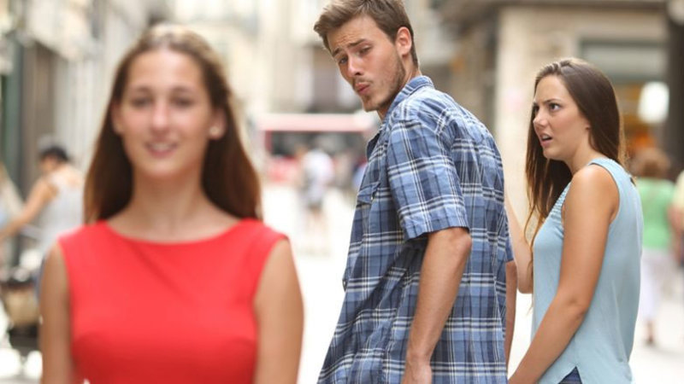
Problem
The problem the team is confronting is the Street harassment in the streets of Medellin, specially that directed to women

Slide 4
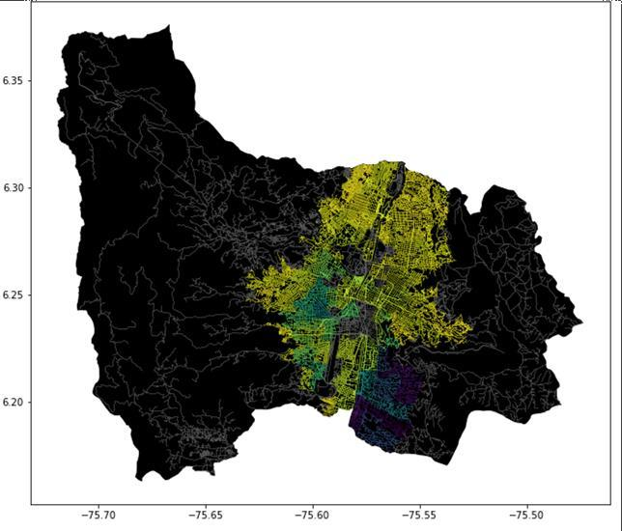
Problem Statement
Constrained Shortest Path Algorithm
Streets of Medellín, Origin and Destination
Constrained Shortest Paths

Slide 5
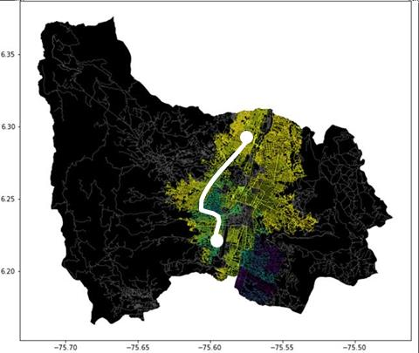
Testing Process
Origin Address
Modified Shortest Path Algorithm
Optimal Path
Destination Address
Risk Threshold
Resulting Route Display

Slide 6
Algorithm Design
Checking over the Risk
Threshold
Resulting Route Display
Animation displaying Dijikstra’s
Algorithm

Slide 7

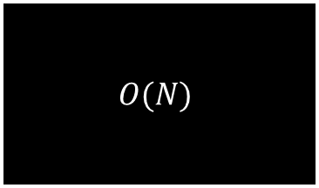
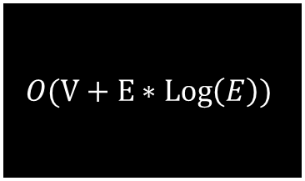
Time and Memory Complexity
Time Complexity
$$O(V+E∗Log\left(E\right))$$
Memory Complexity
$$O(N)$$
Time and Memory complexity of Djikstra’s algorithm where V is the number of vertexes and N is the number of coordinates, and E is the number of edges

Slide 8
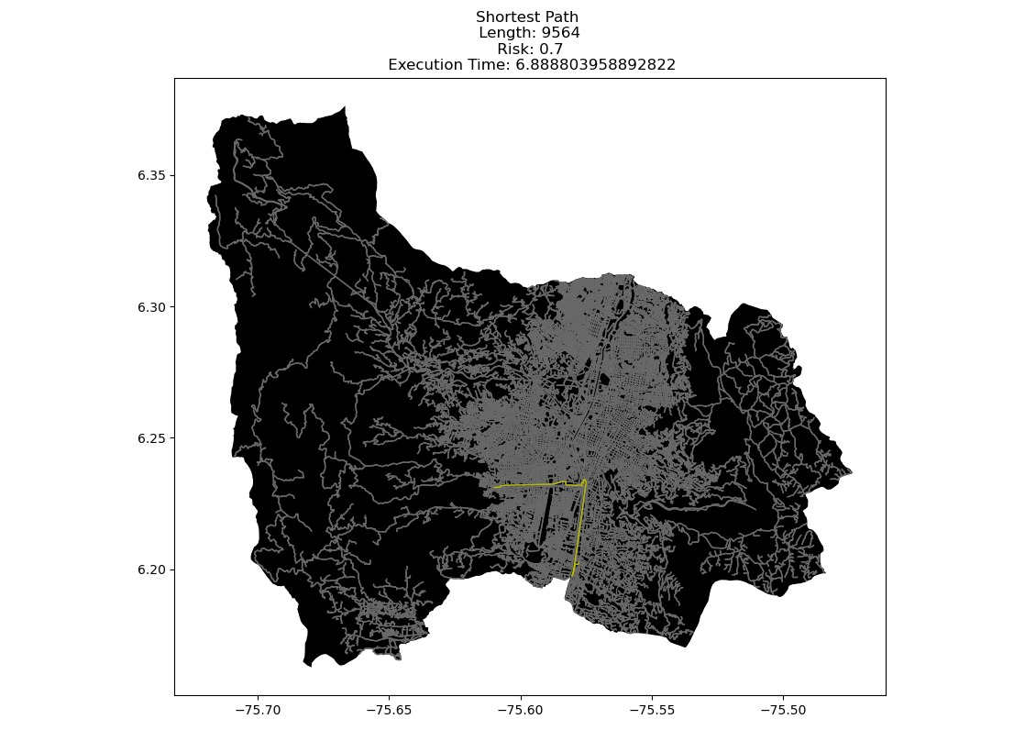
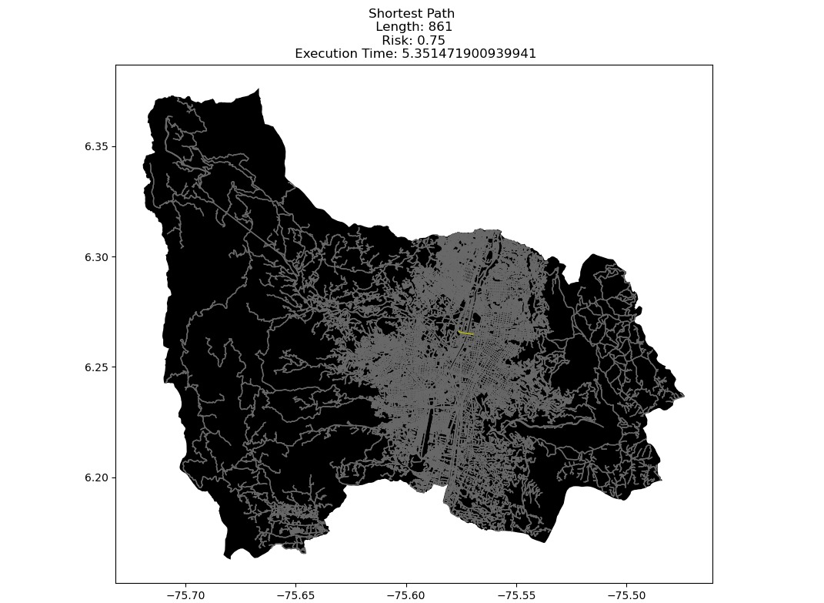
Results (Example Output)

Slide 9
Results
Origin | Destination | Shortest Distance | Without Exceding r
Universidad EAFIT | Universidad de Medellin | 9564 | 0.7
Universidad de Antioquia | Universidad Nacional | 861 | 0.75
Universidad Nacional | Universidad Luis Amigó | 2161 | 0.77

Slide 10







Algorithm Execution Times
Execution Times
6.88 Seconds
5.31 Seconds
5.62 Seconds

Slide 11
Future Work
Web Development
Optimization
Dataset
Improving
Biobjective
optimization
Developing a web app for end user
Modifying Algorithms
Obtaining Data for more cities
Better Complexity

